Slide 1
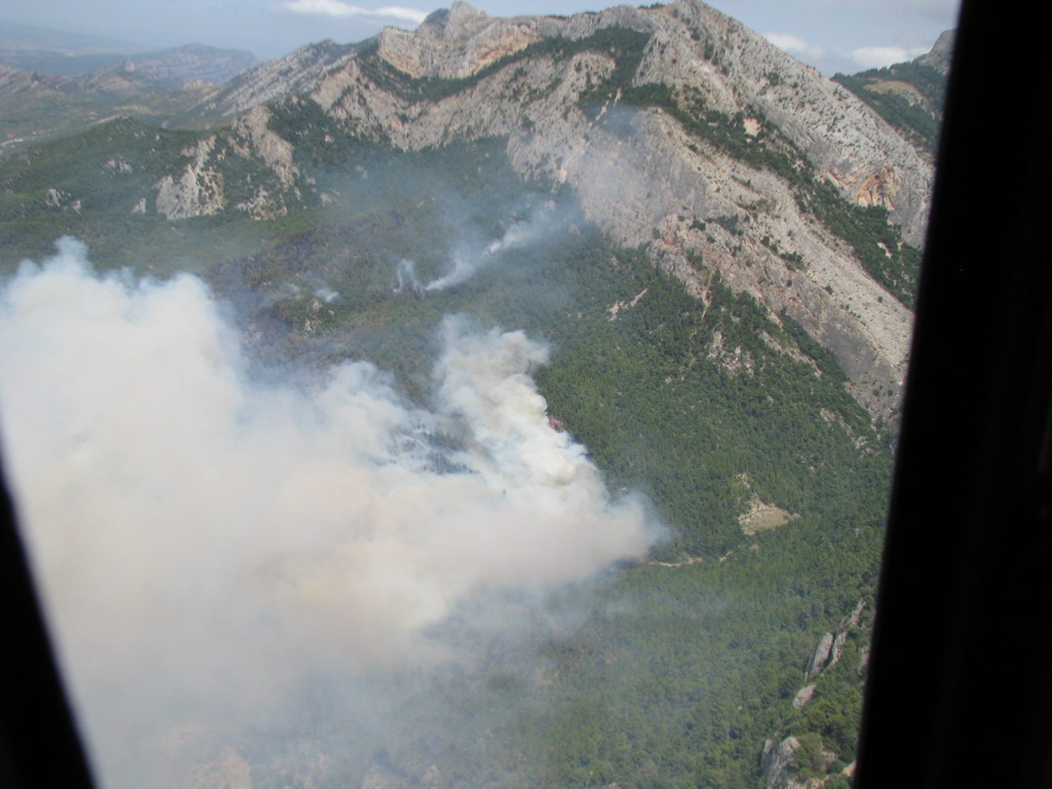
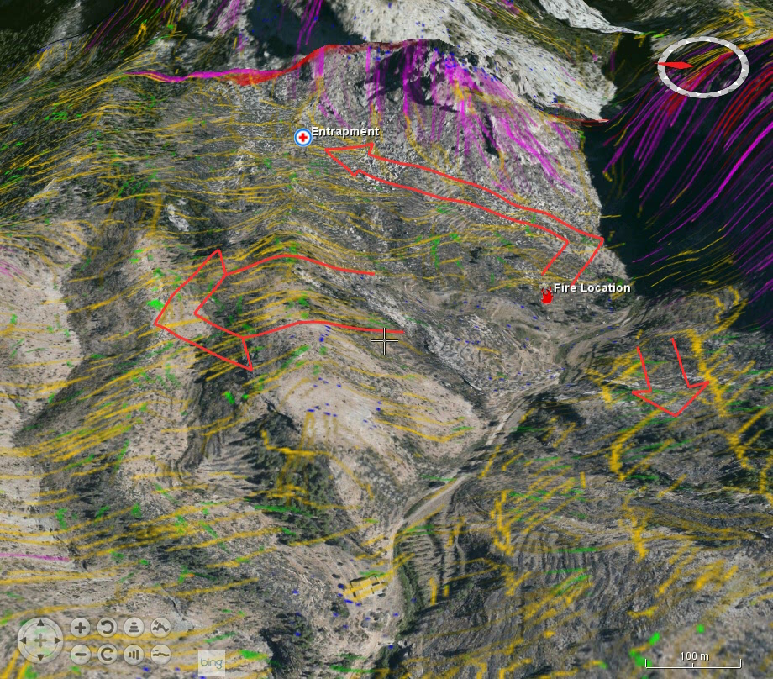
See How Wildfire Moves Over the Terrain
Animated vapor trails show highways of fire and windows of opportunity.
Notes:
Alignment of forces concept to focus on the fire run getting worse or better
Models to create identified fire behavior for every single fire run
Random and chaotic ignitions to look for unpredictable events
Mapping over 3D terrain to show the flux of runs
Concentrate on looking for highways of fire over the landscape
Create a tool that can show how these highways change when the environment changes
New Vision:
We don’t look at a fire spreading, we don’t look to GIS layers of fire behavior....
Instead, we improve the CPS fire path concept and bring it to a new level:
Concentration of paths: highways
Lack of paths: windows of opportunity
Identification of new highways mapped when situations change
Identification of slowing down areas that break highways: good for safety and opportunity of operations
When we look at the landscape, we look at the predictable and unpredictable fire runs, not just the ones that we can see but also the ones we don’t see now--but could happen.
<number>

Slide 2
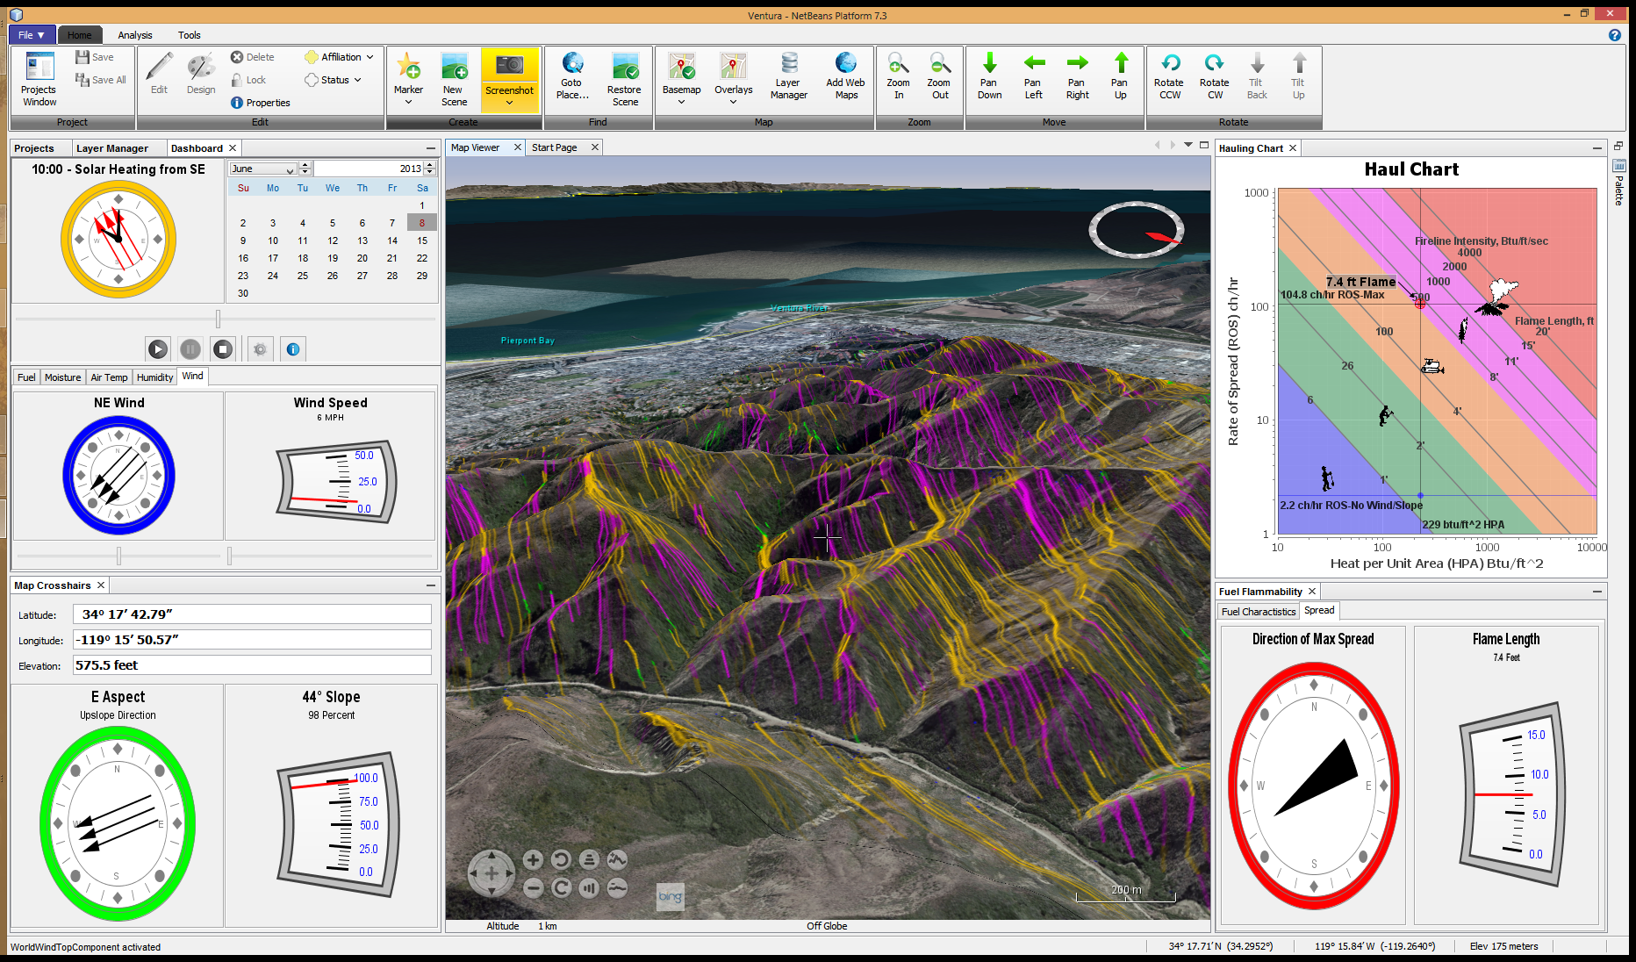
Simplified Display of Complex Data
Controls
Inputs
Location
Outputs
Fire Behavior is worse when the three primary forces are aligned.
Notes:
Controls: Flamingo Ribbon Bar
Simple, touch screen compatible; all features are advertised in menu; collapsible
Inputs: Three primary fire behavior forces are displayed in JFreeCharts
Solar Preheating of Fuels
Wind Speed and Direction
Terrain Slope and Aspect
Location: 3D Virtual Earth, Maps and Terrain Model by NASA WorldWind SDK
WMS maps and imagery
Terrain model provides slope and aspect at crosshairs
Touch screen compatible
Animated vapor trails (comet trails) representing flame lengths and speeds
Outputs: Fire behavior outputs displayed in JFreeCharts
Color coded Haul Chart used by firefighter community
Fireground animations use same color codes as Haul Chart
<number>

Slide 3
CPS Plugin
Software Architecture
Emxsys APIs
WorldWind NetBeans Module
NetBeans Platform
Libs: VisAD, JFreeChart
WorldWind SDK
NetBeans manages the installation, discovery and update of service providers and ancillary modules.

Slide 4
Fireground Module
NetBeans Modular Architecture
Time API
Weather API
Wildfire API
Fuel Model Service Providers
USA LANDFIRE WMS
Catalonia GeoTiffs
Manual Fuel Model Selection
NetBeans manages the installation, discovery and update of service providers and ancillary modules.

